Slide 1


SAP CLOUD APPLICATION PROGRAMMING AND XSA TRAINING IN BTP
Anubhav Oberoy
Day – 5

Slide 2

Agenda – Day 5
Modeling in SAP HANA Cloud
Legacy v/s new approach of modeling
Types of calculation views in HANA
Creating Dimension Model
Creating CUBE Model
Create CUBE with Star Schema
Expose views using CAP Approach as a service
What is SQL Script?
Advantage of SQL Script
Types of SQL Script
Basic Rules of creating SQL Script
How to create SQL Script in HANA
Create Anonymous Block
Create First Procedure
Expose Procedure as a Service

Slide 3
Modeling in SAP HANA Cloud
With SAP HANA Cloud, the main type of modeling object is called a calculation view. A calculation view can combine data from multiple tables or other views, apply filters, calculate new data and aggregate the data to produce summarizations at any level. The calculation views are developed in SAP HANA Cloud using easy-to-use graphical modeling tools, and are stored in SAP HANA Cloud database. A calculation view, when generated into a run-time object, creates a column view that can be processed by SQL.
So, instead of the application including complex code to process the data, the application now calls the required calculation views and the processing is pushed down to SAP HANA Cloud database. This is efficient in the following ways:
The application code is simplified, as it does not have to deal with many data processing tasks. These tasks are pushed down to SAP HANA Cloud database where in-memory processing takes place.
The processing on the data is carried out where the data resides, so we do not have to move raw data from the database to the application. We only move the results of the data processing to the application.
The calculation views can be reused in multiple applications so we avoid redundancy.
Calculation View
(Design-time Object)
HANA Column View
(Runtime-object)

Slide 4
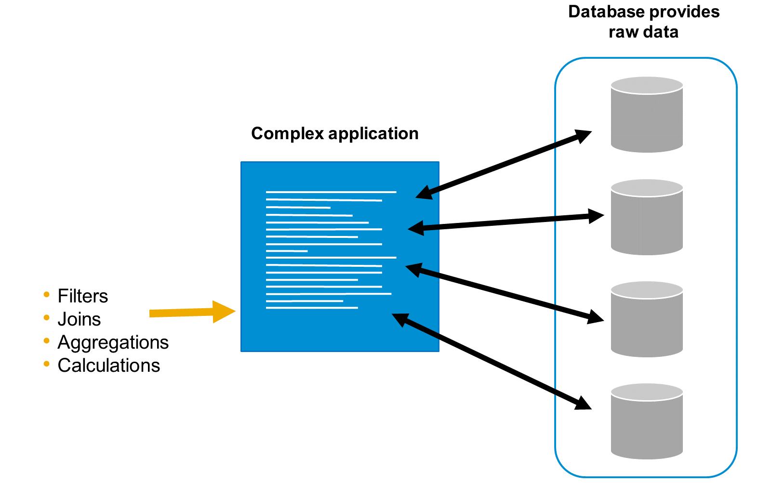
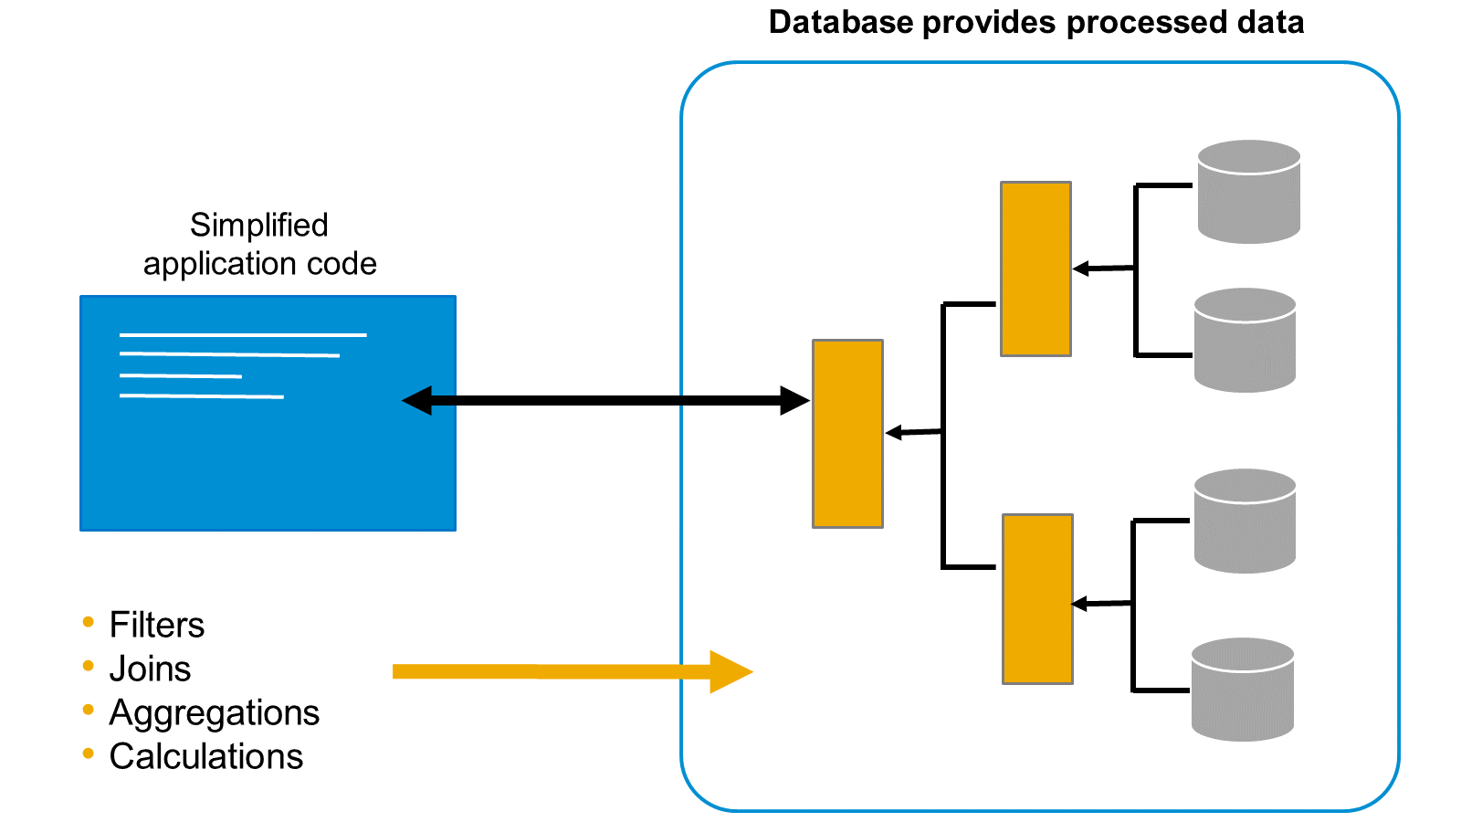
Legacy v/s New Approach of Modeling
Classical Approach
New Approach
The raw data is sent from the database directly to the application. The application then begins to process the data by combining it, aggregating it, and performing calculations in order to generate something meaningful. When we move raw data to the application layer, we make the application code very complex
With SAP HANA Cloud, we can build a sophisticated modeling layer on top of the database tables, right inside the database. This means we can first process the raw data and turn it into something meaningful in the database before passing it to the application for consumption.

Slide 5
Types of Calculation Views in HANA
The calculation view is the main modeling object in SAP HANA Cloud.
There are three types of calculation view:
Dimension - The purpose of a dimension type of calculation view is to define a group of related attributes. For example, a material dimension might include attributes such as material description, material color, material weight, and material price. It might be helpful to think of calculation views of type dimension as central master data views. You define them once and reuse them many times.
Cube without star schema-This type of calculation view is used to define a data set comprised of attributes and measures. This means they are ideal for transactional data modeling. A Cube calculation view can consume other Cube calculation views or dimension calculation views. A cube calculation view is a relational model not a dimensional model.
Cube with star schema-This model is based on the cube type of calculation view, but with one or more dimension calculation views joined to the cube. This provides a very powerful and flexible dimensional data model that enables drill-down, slice and dice analysis over any combination of attributes and measures.
Calculation views are created using a graphical editor with the tool Business Application Studio. To develop a calculation view you should be familiar with basic data modeling concepts.

Slide 6
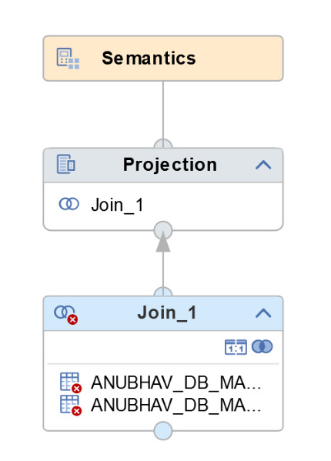
Hands-on - Creating Dimension Model
Create a new DIMENSION model to prepare master data for Business Partners and Business Partners Address.
Solution Source Code : CV_BP.hdbcalculationview

Slide 7
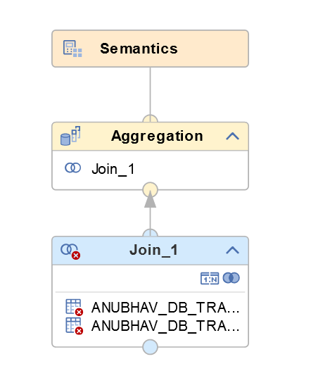
Hands-on - Creating CUBE Model
Create a new CUBE model to prepare transaction data for Purchase order header and Purchase Order Items
Solution Source Code : CV_PURC.hdbcalculationview

Slide 8
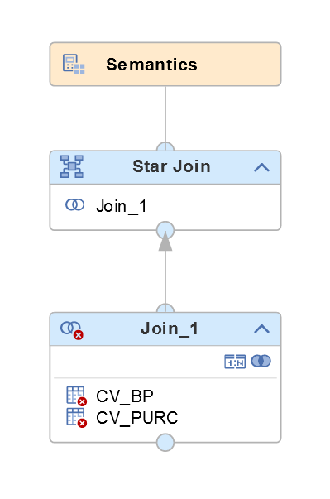
Hands-on - Creating CUBE Model (Star-join)
Create a new CUBE model to prepare data for analytics by combining master and transaction data using star join.
Solution Source Code: CV_PURCHASE.hdbcalculationview

Slide 9
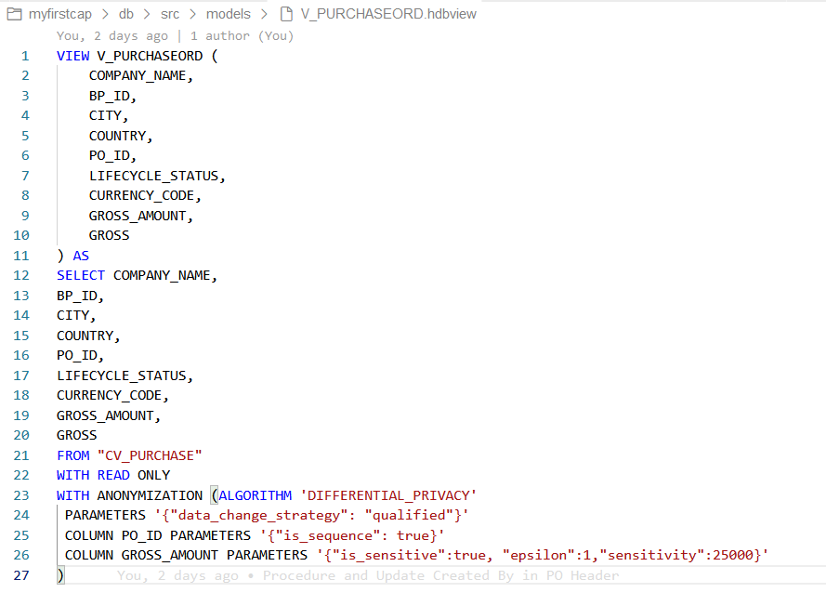
Hands-on - Creating Plain HANA View
Create a plain HANA View on top of calculation view to anonymize data.
Disclaimer: the data type is current unsupported.
Solution Source Code: V_PURCHASEORD.hdbview
REFRESH VIEW view_name ANONYMIZATION;

Slide 10
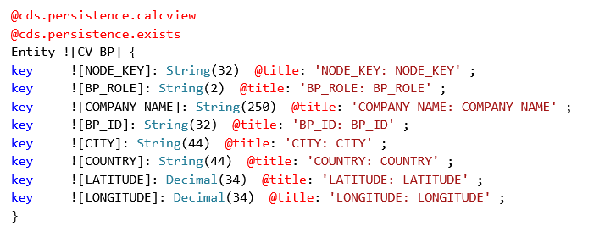
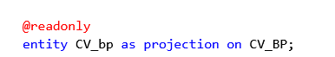
Expose View as a Service in CAP
Following are the steps to expose a view as a CAP Service in BTP
Go to the db folder inside the CAP project – cd db
Compile the View code to CDS code – hana-cli inspectView –v VIEW_NAME -o cds
Copy the generated code to the datamodel.cds file with below annotations
@cds.persistence.calcview
@cds.persistence.exists
Expose the service in CatalogService.cds file as a @readonly Entity
Test the OData Service

Slide 11
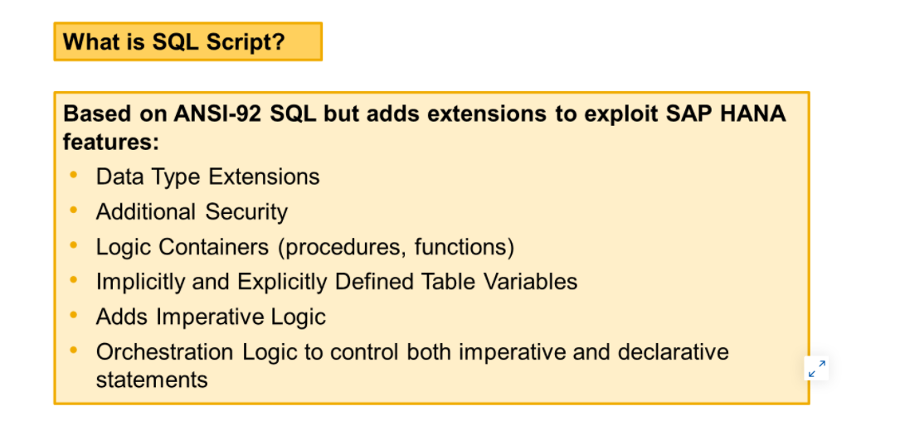
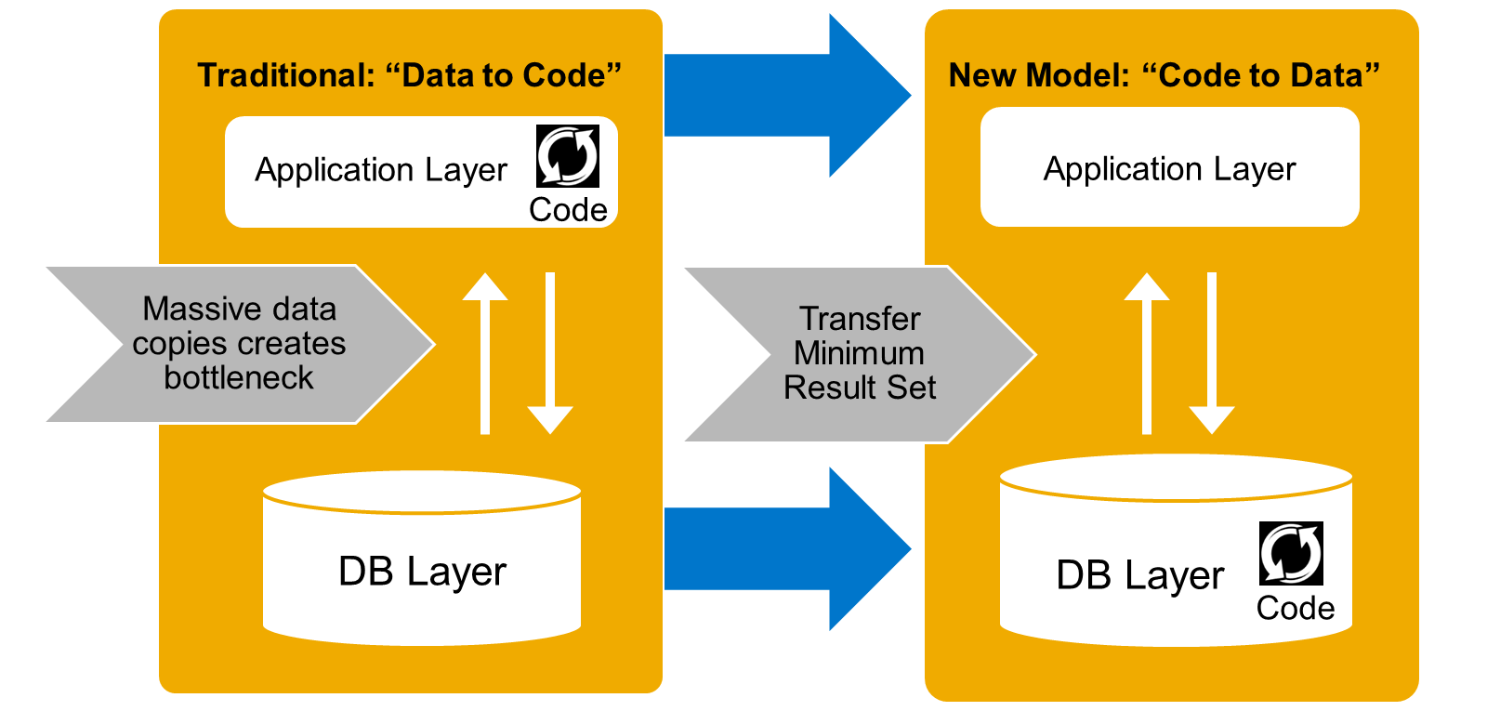
What is SQL Script?
SQL Script is a set of extensions added on top of standard SQL. It is used to exploit the specific features of SAP HANA.
By using these extensions, SQL Script allows much more pushdown of the data–intensive processing to the SAP HANA database, which otherwise would have to be done at the application level.
Applications benefit most from the potential of SAP HANA when they perform as many data-intensive computations in the database as possible. This avoids loading large amounts of data into an application server separate from SAP HANA, and leverages fast column operations, query optimization, and parallel execution.

Slide 12
Advantage of SQL Script
Compared to standard SQL, SQLScript provides the following advantages:
Using SQLScript, complex logic can be broken down into smaller chunks of code. This encourages a modular programming style which means better code reuse. Standard SQL only allows the definition of SQL views to structure complex queries, and SQL views have no parameters.
SQLScript supports local variables for intermediate results with implicitly-defined types. With standard SQL, it would be required to define globally visible views even for intermediate steps.
SQLScript has flow control logic such as if-then-else clauses that are not available in standard SQL.
Stored procedures can return multiple results, while a standard SQL query returns only one result set.
Pushing the processing to SAP HANA is beneficial because there are lots of opportunities for SAP HANA to optimize the execution with in–memory, parallel processing.
Standard SQL does not provide sufficient syntax to push many calculations to the database and as a result, the application layer has to take on this duty. This means huge amounts of data must be copied between the database server and the application server.

Slide 13
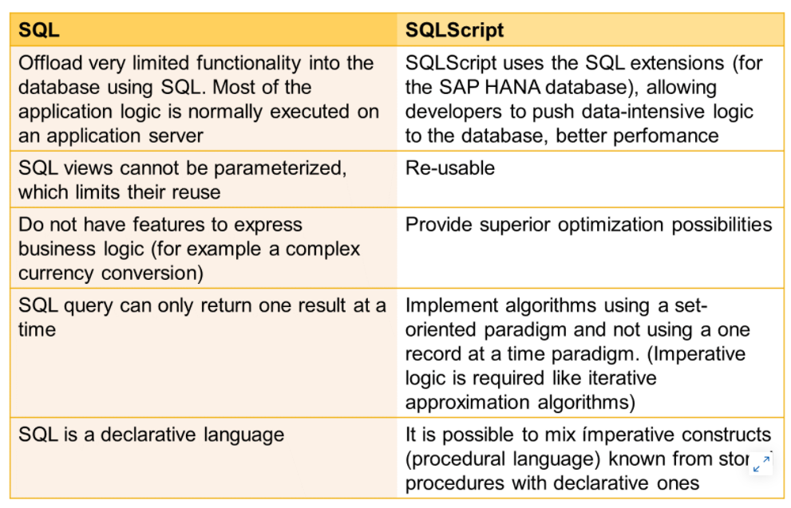
Standard SQL VS. SQLScript

Slide 14
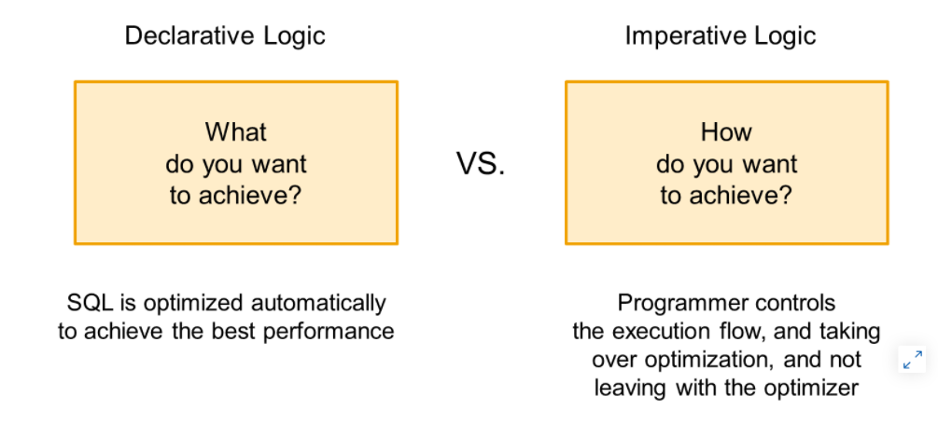
Types of SQL Script
SQL is a descriptive language that is sometimes called a declarative language.
Declarative logic allows the developer to declare the data selection via SELECT statements, as follows:
The developer defines the what.
The engine defines the how, and executes accordingly.
This enables massive parallelization.
Imperative logic allows the developer to control the flow of the logic within SQLScript using the following:
Scalar variable manipulation
DDL/DML logic
WHILE loops
Branching logic based on some conditions, for example IF/ELSE

Slide 15
Basic Rules of creating SQL Script
SQLScript is not case-sensitive like ABAP
Every SQL Script statement ends with semi-colon ;
When we create a variable and assign a value to it, we directly use variable name, but when we want to use the value of the variable we need to use the value of operator colon (:)
Declare x integer;
Declare y integer;
Declare z integer;
x = 10; z = :x + :y;
When we create a variable and do not assign value to it, a null will be assigned. And any operation will null will become null.
One of the best way to achieve code-to-data because the entire logic is processed inside the HANA system
In SQL script, everything evolves around SQL so even when we want to print a result on the screen we will use the SQL statement against a standard sap table called DUMMY;
In SQL script = is comparison operator and := is the assignment operator
When we open SQL Console, it always attaches to user’s local schema. Which means any runtime object created by console will go to user’s local schema (like local development in abap) - select current_schema from dummy
When we try to read data, we need to put schema name before table name in console
So we can also set the default schema using SET SCHEMA schema_name

Slide 16
How to create SQL Script in HANA
Containers
Contain SQL Script Code
Functions (UDF)
Anonymous Block
Stored Procedures
Scalar
Table
Used for one time usage
Training, demo and testing
Do not store code
Complied every time we run
DO BEGIN
--Coda
END;
Code is compiled and stored in DB
Complete Reusability
Think about Function Modules in SAP ABAP
Can have IN, OUT, INOUT parameters
CREATE PROCEDURE procname(IN,OUT,..)
DEFAULT SCHEMA schemaname
READS SQL DATA
AS BEGIN
--Coda SQL Script
END;
User Defined Functions – UDF
Always have ONLY one RETURN parameter
Can have multiple Input parameters
Depending on return data, we will categorize
CREATE FUNCTION procname(....)
RETURNS datatype
DEFAULT SCHEMA schemaname
READS SQL DATA
AS BEGIN
--Coda SQL Script
END;

Slide 17
Data types in HANA
Data Types
Scalar Variables
Arrays
Tables
Used to store only one value
Used DECLARE statement
Char, Varchar, Nvarchar, String
DATE, TIMESTAMP
Integer, BIGINT, TINYINT, DECIMAL
CLOB, BLOB
Store multiple values of same data type
DECLARE arr_name datatype ARRAY;
Implicit
Explicit
1
Direct
Using Type
2
3

Slide 18
Create Anonymous Block
Anonymous block is an executable DML statement which can contain imperative or declarative statements.
All SQL Script statements supported in procedures are also supported in anonymous blocks. Compared to procedures, an anonymous block has no corresponding object created in the metadata catalog.
An anonymous block is defined and executed in a single step by using the following syntax:
DO [(<parameter_clause>)]
BEGIN [SEQUENTIAL EXECUTION]
<body>
END
<body> ::= !! supports the same feature set as procedure did
Hands-on: Anonymous blocks
Source code for SQL Script Basics

Slide 19
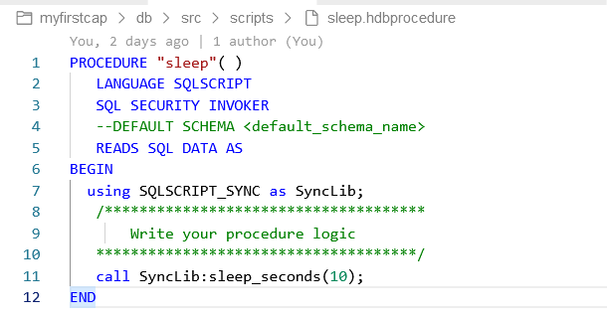
Hands-on: Create First Procedure
Create a simple SAP HANA Stored Procedure that calls the built-in SYNC library to put processing to sleep for 10 seconds.
Source code for Procedure basics

Slide 20
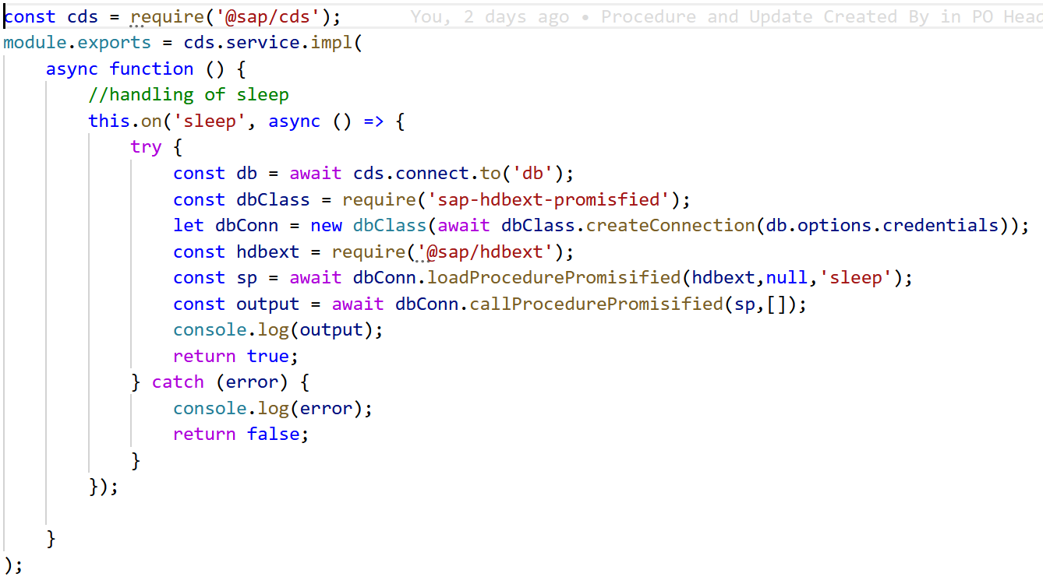
Hands-on: Expose Procedure as a Service
Now we want to add this Procedure to the CAP service as a function.
Source code for Consume procedure as a Service

Slide 21

End of Day 5

Slide 22

Questions

Slide 23

Anubhav Oberoy

Slide 24


We’re committed to empower you to be
Most Desirable Resource
through powerful training solutions.
We build the workforce of the future.
250+
Corporate Clients
30,000+
Learners Trained
25000+
Learners Placed
FREE WEBINARS
Sign up for free webinars with industry experts every fortnight!
Enroll Now!
Contact us today!
https://anubhavtrainings.com/

Slide 25




More from AnubhavTrainings.com

Slide 26
Title
Content

